Slide 1
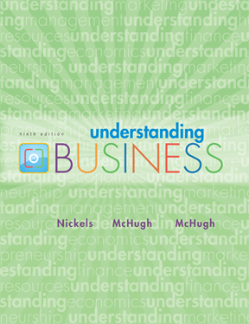

*
Chapter Two
*
Understanding How Economics Affects Business
McGraw-Hill/Irwin
Copyright © 2010 by The McGraw-Hill Companies, Inc. All rights reserved.

Slide 2
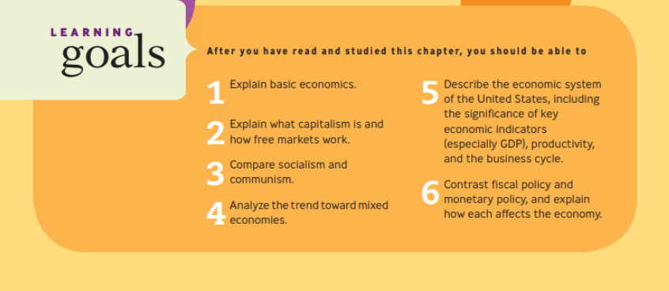

Slide 3
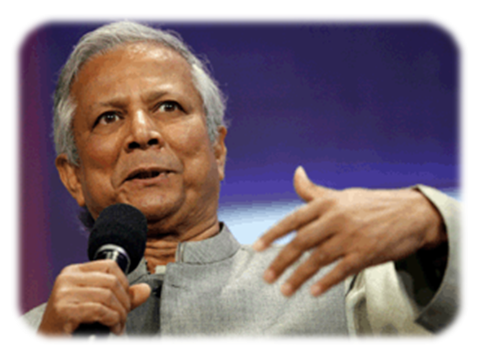
Microcredit for small business start-ups – a miracle cure for poverty?
MUHAMMAD YUNUS
Grameen Bank

Slide 4
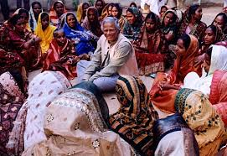
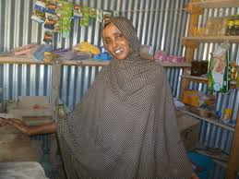
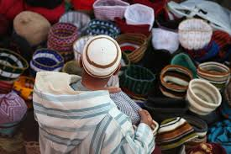
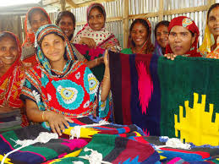
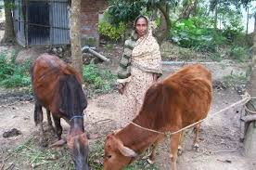
*
Profile
*
Offers microcredits (very small loans) to the poor to start their own businesses.
2-<number>
Notes:
See Learning Goal 1: Explain basic economics.

Slide 5
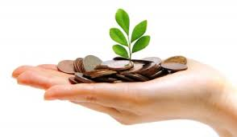
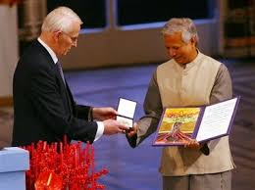
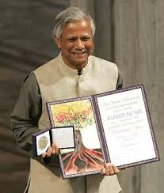
Won the Nobel Peace Prize in 2006.

Slide 6
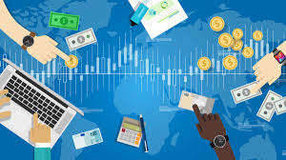

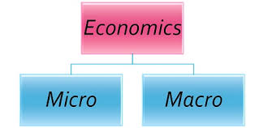
The MAJOR BRANCHES of
ECONOMICS
*
What Is Economics?
LG1
*
Economics -- The study of how society employs resources to produce goods and services for consumption among various groups and individuals.
2-<number>

Slide 7
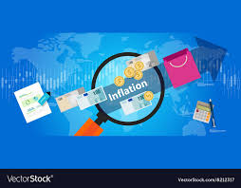

  Macroeconomics -- Concentrates on the operation of a nation’s economy as a whole.

Slide 8
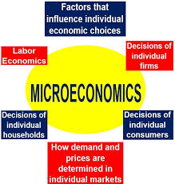
Microeconomics -- Concentrates on the behavior of people and organizations in markets for particular products or services.

Slide 9
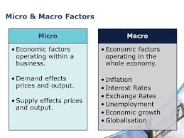

Slide 10

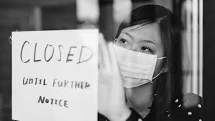
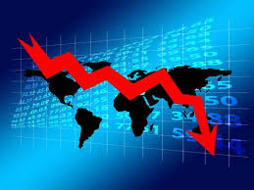
Mini Activity: Which factor is more affected by the current pandemic? (Micro/Macro/Both)
Justify your answer with an example.

Slide 11
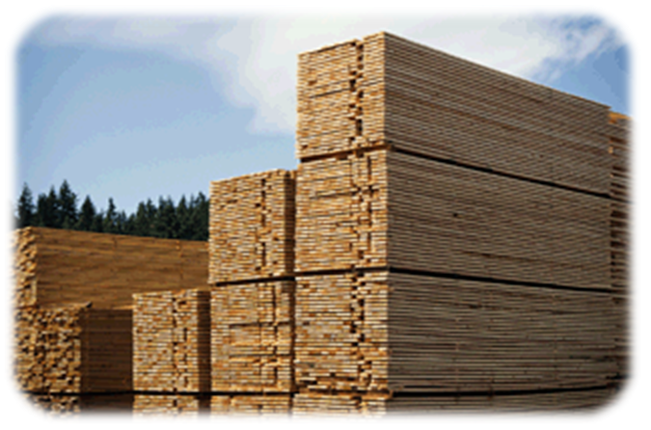
RESOURCE DEVELOPMENT
*
What Is Economics?
LG1
*
Resource Development -- The study of how to increase resources and create conditions that will make better use of them.
2-<number>

Slide 12
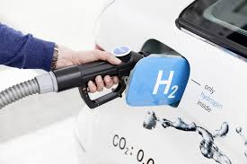
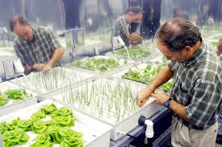
EXAMPLES of WAYS to
INCREASE RESOURCES
*
What Is Economics?
LG1
*
New energy sources
  Hydrogen fuel
New ways of growing foods
  Hydroponics
2-<number>
Notes:
See Learning Goal 1: Explain basic economics.

Slide 13
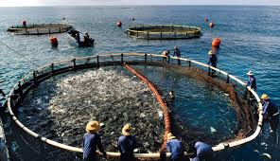
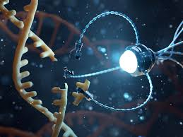
EXAMPLES of WAYS to
INCREASE RESOURCES
*
What Is Economics?
LG1
*
New ways of creating goods and services
  Mariculture
  Nanotechnology
2-<number>
Notes:
See Learning Goal 1: Explain basic economics.

Slide 14


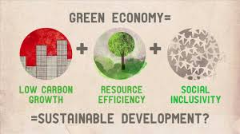
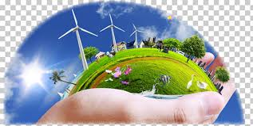
Green Economy
*
The green economy is defined as economy that aims at making issues of reducing environmental risks and ecological scarcities, and that aims for sustainable development without degrading the environment.
*
2-<number>
Notes:
See Learning Goal 1: Explain basic economics.

Slide 15
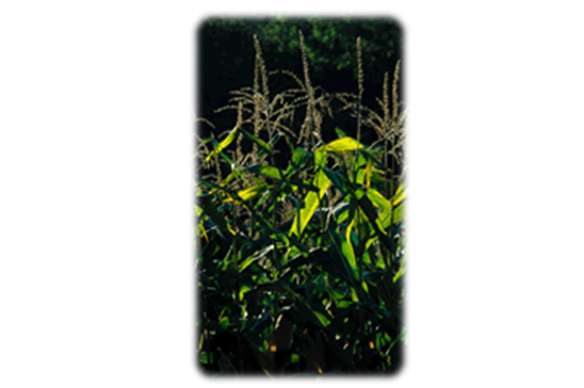
MORE PROFITS FROM the
GREEN REVOLUTION
(Thinking Green)
*
*
The public’s concern with global warming contributed to the success of the Toyota Prius.
Farmers are growing more corn and other crops to use for biofuels.
2-<number>
Notes:
See Learning Goal 1: Explain basic economics.

Slide 16

*
Even companies such as Johnson & Johnson have taken steps to reduce their carbon emissions. They have created plans called Citizenship & Sustainability 2020 Goals that look at on-site CO2 reduction, reduction in water consumption, disposable waste programs, and sustainability improvements for products. This goal aims to help both the company to be more fuel efficient and at-home users to have more green products.
*
2-<number>
Notes:
See Learning Goal 1: Explain basic economics.

